Slide 1
“Teach A Level Maths”
Statistics 1
The Binomial Distribution: Mean and Variance
© Christine Crisp

Slide 2
Statistics 1
AQA
MEI/OCR
OCR
"Certain images and/or photos on this presentation are the copyrighted property of JupiterImages and are being used with permission under license. These images and/or photos may not be copied or downloaded without permission from JupiterImages"

Slide 3
Think back to the binomial distribution, can you recall
3 formulae.
The first one is used to find the probabilities for the table
P(X=x) = .........
Then can you recall the formula we got for
Mean (Mew) or Expectation for a bog standard discrete random
Variable X E(X) = ..........
How about Variance =

Slide 4
There are very simple formulae that we can use to find the mean and variance of a Binomial Distribution.
I’ll illustrate the formulae with an example.

Slide 5











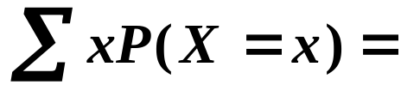



Suppose .
The probability distribution is
Can you find the mean using the formula for any discrete probability distribution?
If you’ve forgotten how to calculate the mean, the results written in a table may remind you:
x
0
1
2
3
mean, μ =
Can you spot the link to the parameters of the distribution ( n = 3 and p = 0·4 )?

Slide 6


Suppose .
The probability distribution is
Can you find the mean using the formula for any discrete probability distribution?
If you’ve forgotten how to calculate the mean, the results written in a table may remind you:
x
0
1
2
3
mean, μ =
ANS: so,

Slide 7
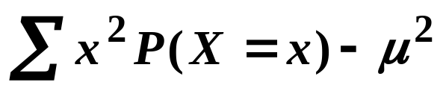
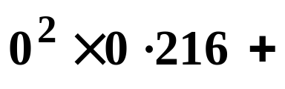
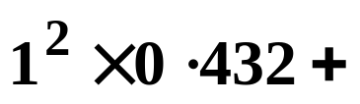

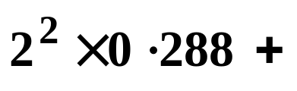
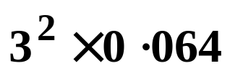
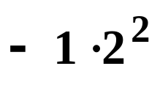


Now for the variance:
x
0
1
2
3
The formula for the variance of any discrete probability distribution is
The link with the parameters isn’t so easy to spot this time but it’s easy to remember. It is
variance

Slide 8



e.g.1 Find the mean and variance of the random variable X where
Solution:
mean,
variance
variance
SUMMARY
The mean of a Binomial Distribution is given by
mean,
variance
The variance is given by

Slide 9











Exercise
1. Find the mean and variance of the random variable X where
(a)
(b)
(c)
(d)
Solutions:
(a)
mean
variance
(b)
mean
variance

Slide 10
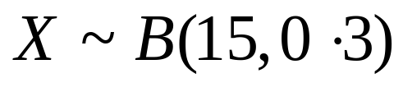






Exercise
1. Find the mean and variance of the random variable X where
(a)
(b)
(c)
(d)
Solutions:
(c)
mean
variance
(d)
mean
variance

Slide 11
Nails are sold in packets of 100. Occasionally a nail is faulty. The number of faulty nails in a randomly chosen packet is denoted by X. Assuming that faulty nails occur independently and at random, find the mean and standard deviation of X.

Slide 12
Given that X~B(10,0.3) a) find E(X) and Var(X). b) calculate P(μ-σ<X< μ-σ)

Slide 13
Given that Y is B(n,p) and E(Y) = 24 and Var(Y) =8. Find the values of n and p.

Slide 14


Slide 15
The following slide contains repeats of information on earlier slides, shown without colour, so that it can be printed and photocopied.

Slide 16
SUMMARY
The mean of a Binomial Distribution is given by
mean,
The variance is given by
variance
e.g.1 Find the mean and variance of the random variable X where
Solution:
mean,
variance
variance

